Slide 1


A PROPOSAL ON “PLANT DISEASE DECTECTION”
Presented By:
Roshani Poudel
Amrita Pant
Paras Ghimire
Subash Ghimire
Submitted To:
Department of Computer Engineering
Graduate School of Engineering
Mid West University, Surkhet
Supervisor:
Er. Sonalal Yadav

Slide 2

OUTLINE
Introduction
Objective
Methodology
System Architecture
Software development life cycle
System Workflow
UML Diagram
Data Analysis
Technical Progress
Future Work
Conclusion
Reference

Slide 3
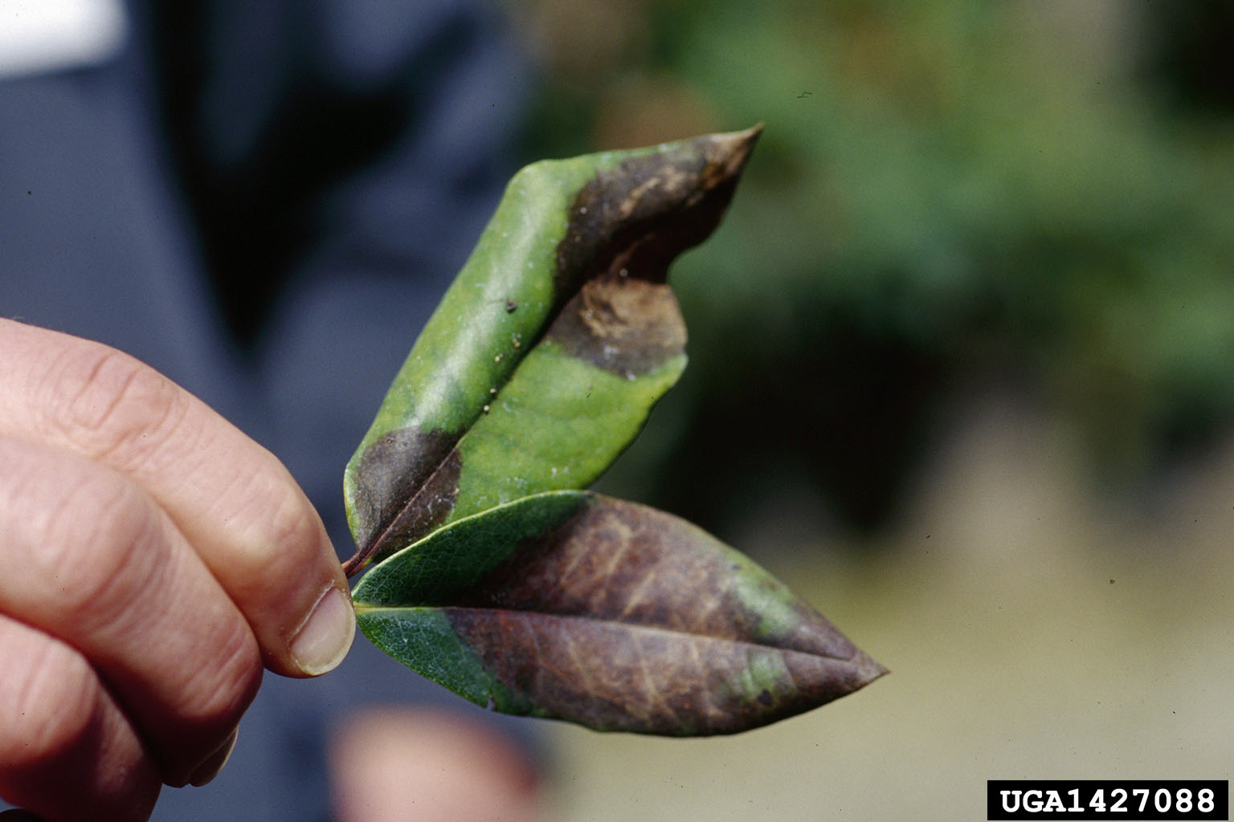
INTRODUCTION
Plant diseases poses significant challenges
Detection of plant disease is crucial at early stage
Traditional methods of disease diagnosis are time consuming and require specialized expertise
Use of ML, CNN and Image processing helps to develop a robust and automated system for plant disease detection

Slide 4
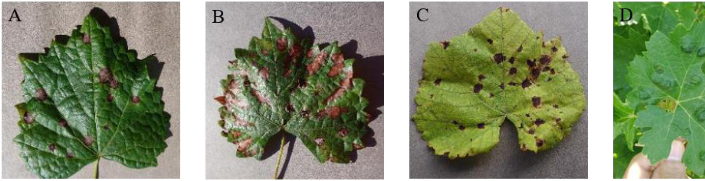
Objective
Develop an automated system that can accurately detect and classify plant leaf diseases using computer vision and machine learning techniques.
Classify the healthy and affected leaf part by feature extraction and classification.
Train the model by using testing data for accurate result.

Slide 5
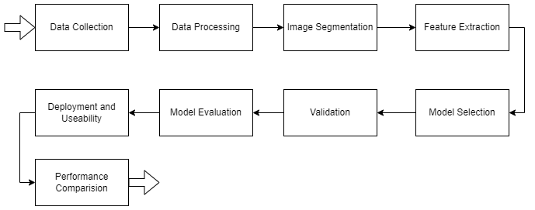
METHODLOGY
METHODOLOGY

Slide 6
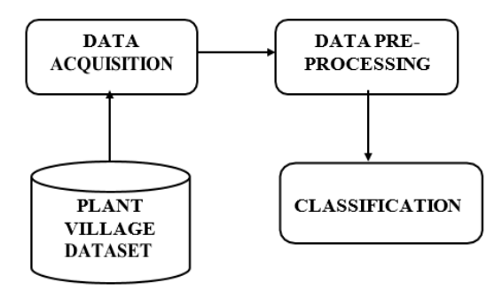
SYSTEM ARCHITECTURE:
System architecture involves data acquisition from a large dataset.
Data undergoes processing through various convolutional layers.
Classification of plant diseases determines if the image belongs to a healthy or diseased class.

Slide 7
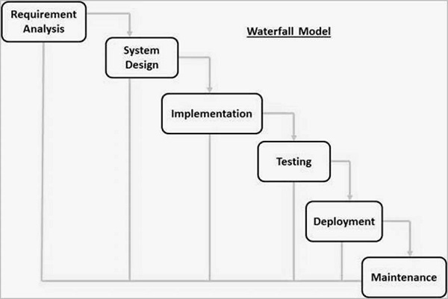
Software development Life cycle:
We use waterfall model software development life cycle in our project.

Slide 8
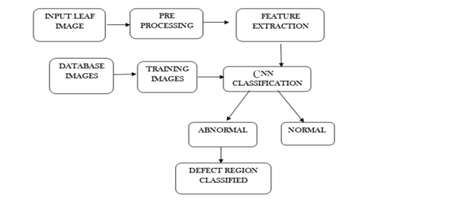
System Workflow

Slide 9
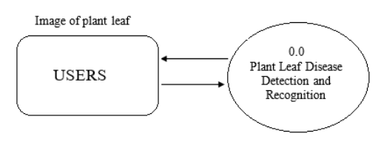
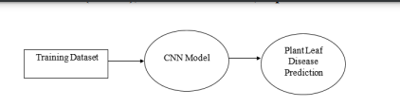
Data flow diagram (DFD):
Data Flow Diagram – Level 0
Data Flow Diagram – Level 1:

Slide 10
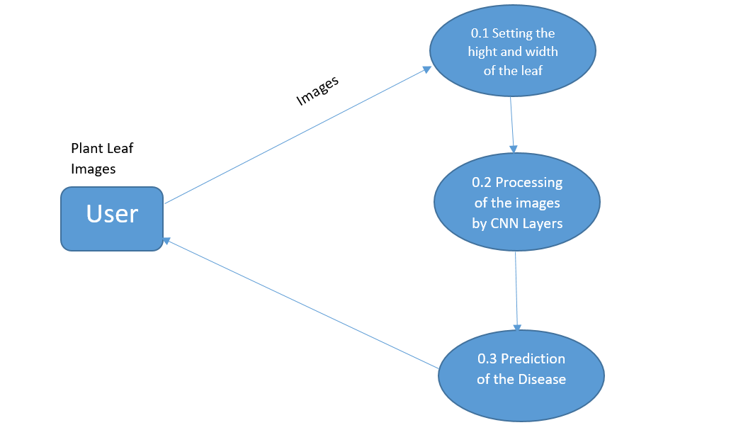
Data Flow Diagram – Level 2:

Slide 11
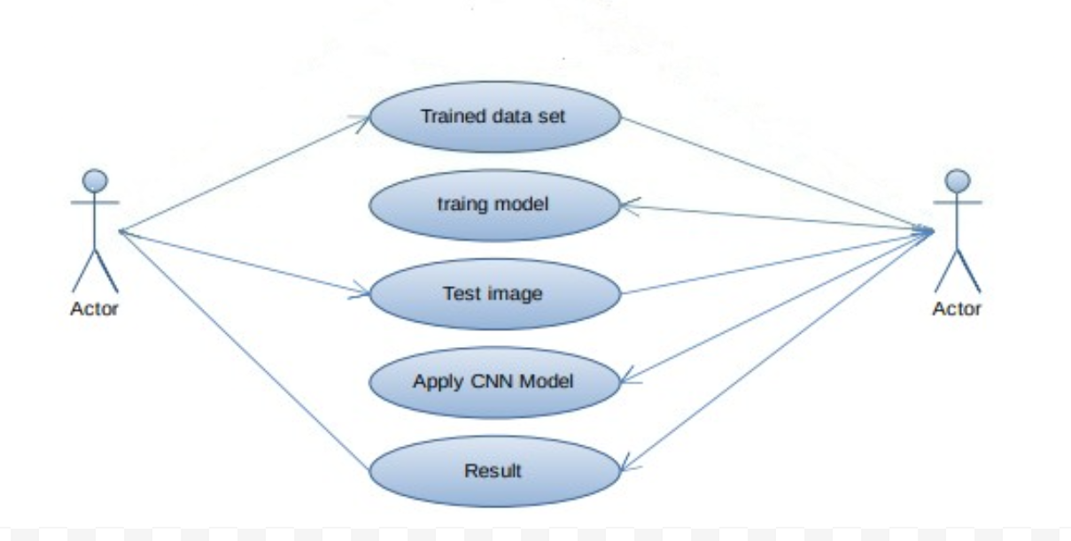
Use -case diagram:

Slide 12
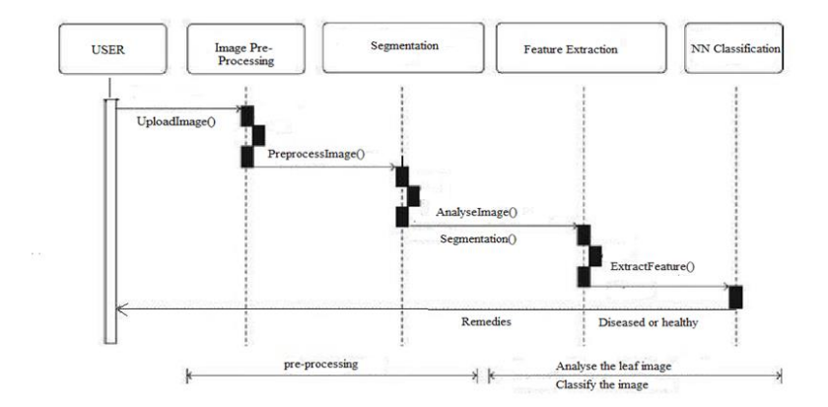
Sequence Diagram:

Slide 13
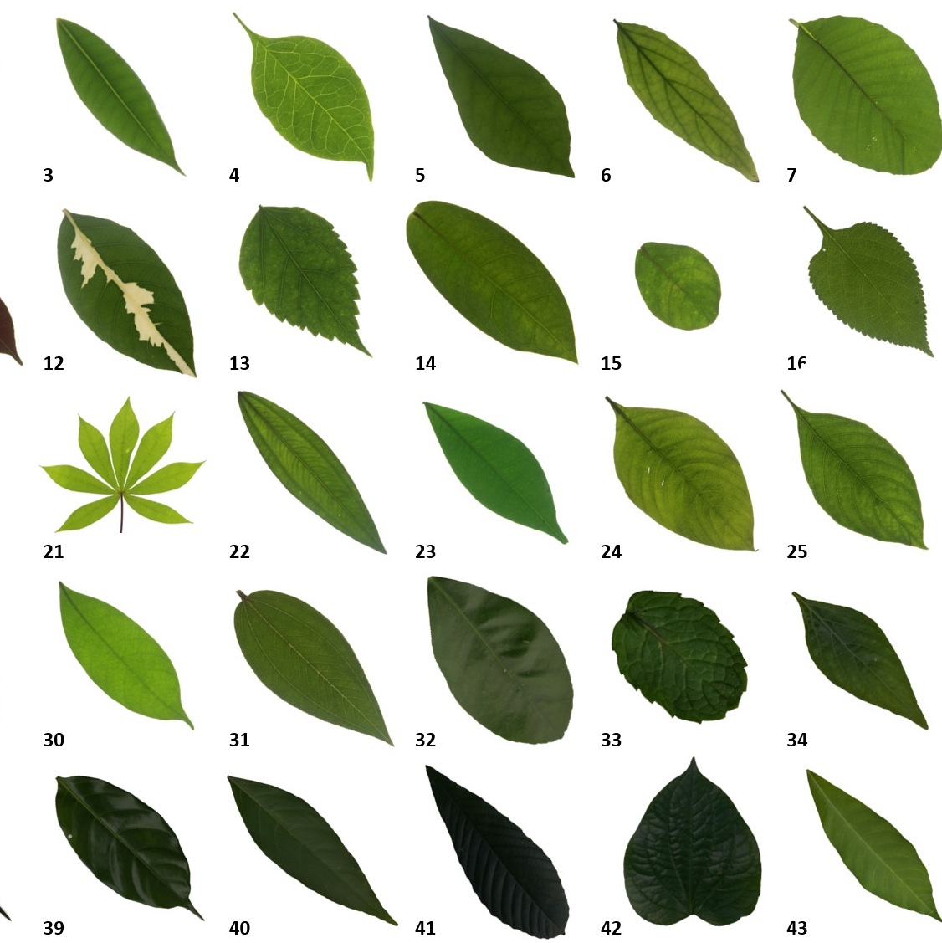
DATA ANALYSIS
Plant leaf dataset downloaded from websites like Kaggle.
Dataset contains images of diseased and healthy plant leaves.
Dataset explored to identify plant species and diseases.
Classification approach used to label leaves as diseased or healthy.
If diseased, the name of the disease and corresponding remedies mentioned.
Methodology focuses on the following steps for classification.

Slide 14
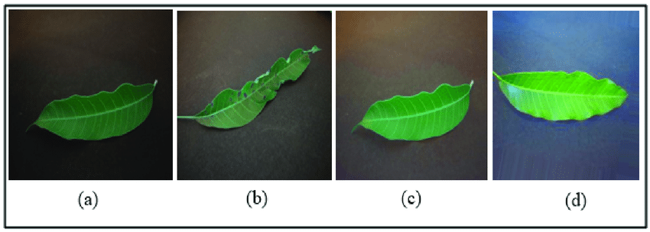
1. Data Collection:
Gather diverse dataset of plant images (healthy and diseased).
Sources include public databases, collaboration with farmers, and capturing our own images.
Dataset consists of mango plant leaf images.
Categorized into healthy and diseased classes.

Slide 15
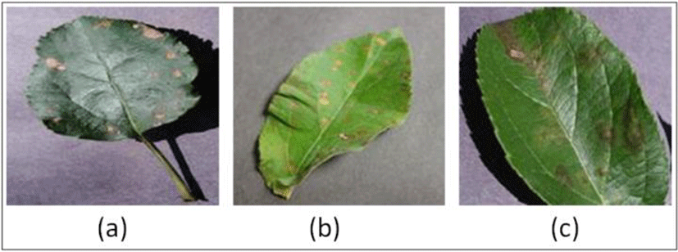
2. Image Processing:
Clean and preprocess collected images for quality enhancement.
Techniques include resizing, cropping, color normalization, and noise reduction.
Function of this stage:
Train the collected dataset for image classification.
Test captured plant leaf images for disease detection.

Slide 16
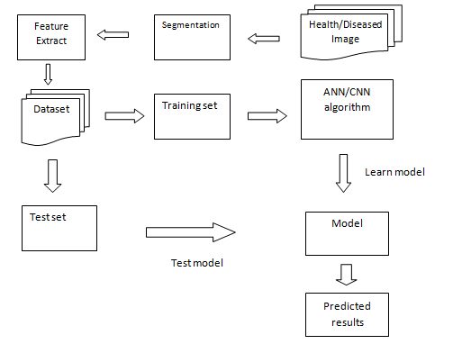
3. Procedure:
Digital Image Processing involves sequential stages and algorithms.
Flowchart represents the controlled flow of image processing steps.

Slide 17
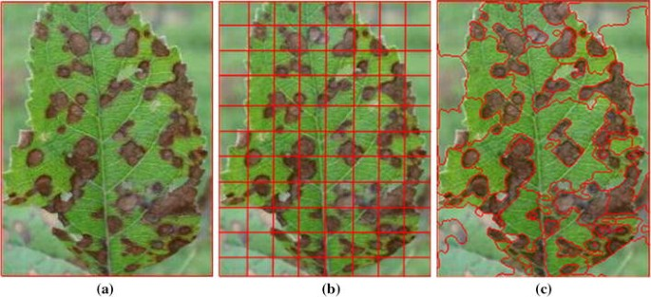
4. Image segmentation:
Apply image segmentation techniques to isolate plant regions from the background.
Segmentation helps focus analysis on relevant areas.
This step separates plant regions from the rest of the image.

Slide 18
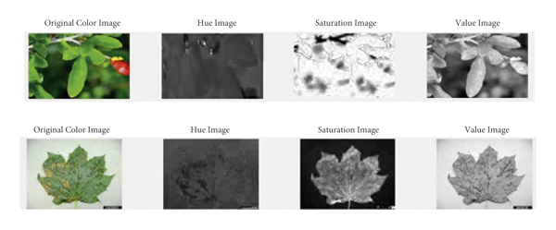
5. Feature extraction:
Extract meaningful features from segmented plant images.
Features capture patterns of healthy and diseased plants.
Use Otsu classifier and k-means clustering for image segmentation.
Transform RGB color model to Lab color model for efficient clustering.

Slide 19

6. Model selection:
Choose a suitable ML or DL model for disease classification.
Convolutional Neural Networks (CNNs) commonly used for image classification.
Consider pre-trained models like VGG, ResNet, or Inception.

Slide 20
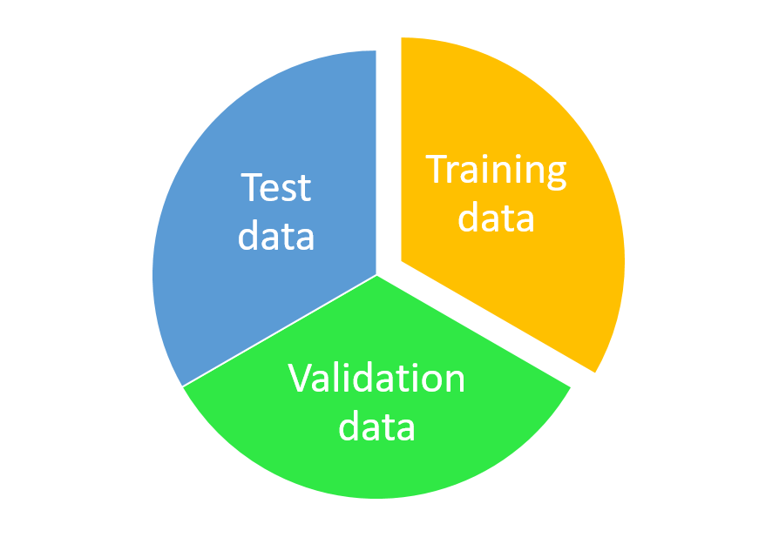
7. Training and validation:
Split dataset into training and validation sets.
Train selected model on the training set.
Fine-tune model parameters to optimize performance.
Monitor performance using validation metrics (accuracy, precision, recall, F1-score).

Slide 21
8. Model evaluation
Evaluate trained model on a separate test set.
Test set should not be used during training.
Calculate performance metrics to assess accuracy and generalization.
Consider using confusion matrices to analyze classification performance for each disease class.

Slide 22
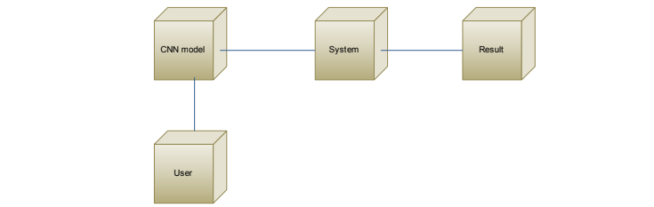
9. Deployment and usability:
Develop a user-friendly interface or application for practical use of the model.
Options include mobile app or web-based tool.
Users can upload plant images for disease detection.
Interface allows easy interaction and utilization of the model.

Slide 23
10. Performance comparison
Compare the performance of the developed model with existing methods or models.
Evaluate accuracy, speed, and resource requirements.
Comparison helps assess the effectiveness of the developed approach.
Provides insights into the model's advantages and potential improvements.

Slide 24
TECHNICAL PROGRESS
Prototype model identifies leaf health as either healthy or unhealthy.
categorization of specific diseases has not been incorporated into the prototype yet.
The prototype undergoes several processes and steps as outlined below:

Slide 25
a. Dataset Collection:
Mango leaf image dataset was collected from Kaggle, an online platform for sharing datasets and data-related projects.
Specific mango leaf image datasets aligned with the project objectives were searched and evaluated.
A suitable dataset was selected, containing labeled images of mango leaves with various health conditions, diseases, and disorders.

Slide 26
b. Model Development:
Deep learning model based on CNN is designed.
Architecture includes convolutional and pooling layers.
Fully connected layers used for classification.
Model trained on collected dataset using advanced optimization algorithms.

Slide 27
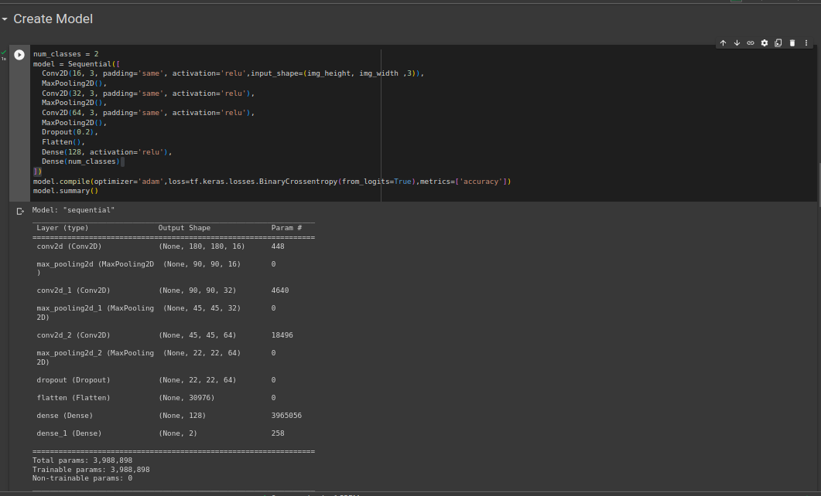

Slide 28
c. Model Training:
The collected dataset is used to train the designed model.
Labeled images are fed into the model during the training process.
The model iteratively adjusts its parameters to minimize prediction errors.
Training enables the model to learn the distinguishing features of healthy and diseased mango leaves.

Slide 29
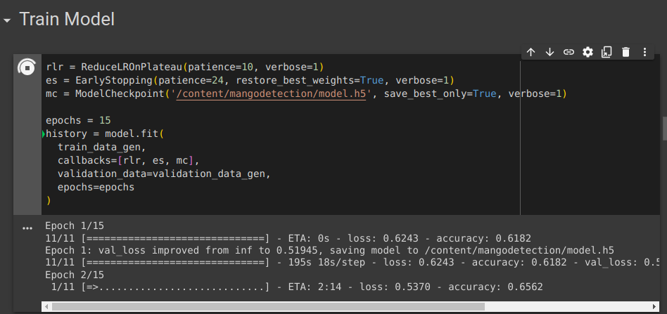

Slide 30
d. Normal Inference of Trained Model:
Trained model used for inference on new, unseen leaf images.
Images passed through the model to make predictions.
Predictions include classification as healthy or diseased.
Confidence scores generated to indicate prediction certainty.
Enables system to provide accurate and real-time results to users.

Slide 31
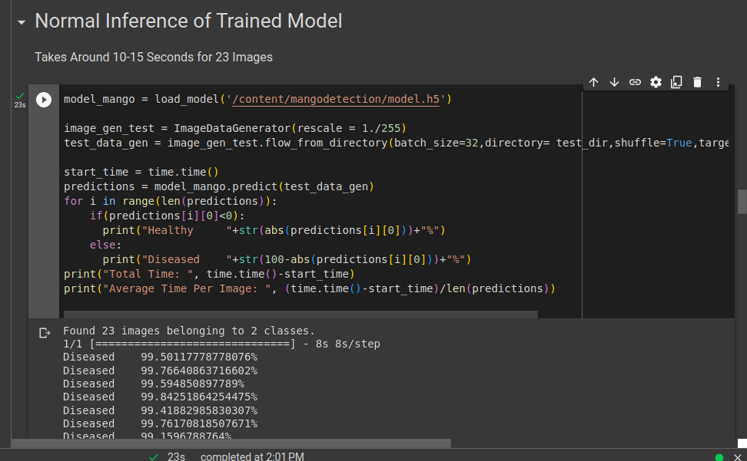

Slide 32
Future Work
Till now we have completed 30% of our work and we will perform remaining 70% work in next semester.
The remaining future work may include:
Expand model to classify specific diseases.
Extend system to detect diseases in multiple plant species.
Develop real-time disease monitoring.
Enhance system to assess disease severity.
Incorporate user feedback for system improvement.

Slide 33
CONCLUSION
Proposed plant leaf disease detection system aims to improve plant yield for farmers.
Utilizes image processing and machine learning techniques.
Focuses on accurately detecting common leaf diseases.
Modules include pre-processing, segmentation, and feature extraction.
Aims to simplify the life of farmers and enhance agricultural productivity.

Slide 34
REFERENCE
[1] Sankaran, S.; Mishra, A.; Ehsani, R. “A review of advanced techniques for detecting plant diseases”. Comput.Electron. Agric. 2010, 72, 1–13. [CrossRef]
[2] Chaerani, R.; Voorrips, R.E. “Tomato early blight (Alternariasolani): The pathogens, genetics, and breeding for resistance”, J. Gen. Plant Pathol. 2006, 72, 335–347. [CrossRef]
[3] Alvarez, A.M.” Integrated approaches for detection of plant pathogenic bacteria and diagnosis of bacterial diseases”, Annu. Rev. Phytopathol. 2004, 42, 339–366. [CrossRef] [PubMed]
[4] ] Abu Sarwar Zamani, L. Anand et.al, “performance of Machine Learning and Image Processing in plant leaf Disease Detection”, Journal of Food Quality, 26 Apr 2022.
[5]Sushil R. Kamlapurkar,” Detection of Plant Leaf Disease Using Image Processing Approach,” International Journal of Scientific and Research Publications, Volume 6, Issue 2, pp.1-6. February 2016
[6] Shima Ramesh Maniyath, Vinod P V, Hebbar Ram, "Plant Disease Detection Using Machine Learning,"in Research Gate, April 2018. Availabe https://www.researchgate.net/publication/327065422 . Accessed on: May 2023
[7] Usha Kumari, " Leaf Disease Detection: Feature Extraction with K-means clustering and Classification," in Research Gate, March 2019. Available: https://www.researchgate.net/publication/335495508. Accessed on: May 2023

Slide 35
[8] Shitala Prasad, Sateesh K. Peddoju, Debashis Ghosh ,“Multi-resolution mobile vision system for plant leaf disease diagnosis,” pp. 379–388, Springer-Verlag London 2015
[9] Shanwen Zhang, Zhuhong You, Xiaowei Wu,” Plant disease leaf image segmentation based on superpixel clustering and EM algorithm,” Springer, June 2017.
[10] Zulkifli Bin Husin, Abdul Hallis Bin Abdul Aziz, Ali Yeon Bin Md Shakaff Rohani Binti S Mohamed Farook, “Feasibility Study on Plant Chili Disease Detection Using Image Processing Techniques”, 2012 Third International Conference on Intelligent Systems Modelling and Simulation.
[11] Wenjiang Huang, Qingsong Guan, Juhua Luo, Jingcheng Zhang, Jinling Zhao, Dong Liang, Linsheng Huang, and Dongyan Zhang,“New Optimized Spectral Indices for Identifying and Monitoring Winter Wheat Diseases”, IEEE journal of selected topics inapplied earth observation and remote sensing, Vol. 7, No. 6, June 2017
[12] Keyvan Asefpour Vakilian & Jafar Massah,” An artificial neural network approach to identify fungal diseases of cucumber (Cucumis sativus L.) Plants using digital image processing,” Vol. 46, No. 13,1580–1588, Taylor &Francis, 2013
[13] : Vijai Singh, A.K. Misra,” Detection of plant leaf diseases using image segmentation and soft computing Techniques,”Information Processing In Agriculture 4 (2017) 41–49 , science direct, 2017

Slide 36
[14] Srdjan Sladojevic, Marko Arsenovic, Andras Anderla, Dubravko Culibrk and Darko Stefanovic,”Deep Neural Networks Based Recognition of Plant Diseases by Leaf Image Classification,” Hindawi Publishing Corporation Computational Intelligence and Neuroscience,Vol 2016, Article ID 3289801, 11 pages
[15] Usama Mokhtar, Mona A. S. Ali, Aboul Ella Hassenian, Hesham Hefny,” Tomato leaves diseases detection approach based on support vector machines,” IEEE,2015
[16] Amar Kumar Dey, Manisha Sharma, M.R.Meshram,”Image Processing Based Leaf Rot Disease, Detection of Betel Vine (Piper BetleL.),” Procedia Computer Science 748 – 754, science direct, 2016
[17] no.4, 299–315, Taylor & Francis, 2017[15] H.Al-Hiary, S. Bani-Ahmad, M.Reyalat, M.Braik & Z.AlRahamneh, “Fast and Accurate Detection and Classification of Plant Diseases”, International Journal of Computer Applications, Vol.17,No.1, pp.31-38.March 2011.

Slide 37
Thank You.

